Slide 1
Flutter Introduction
Mohamed Elbaiomy

Slide 2
Agenda
09:00 : 09:30
12:00 : 12:30
09:30 : 12:00
12:30 : 2:30
Registration
Speaker/Break
Session
Workshop

Slide 3

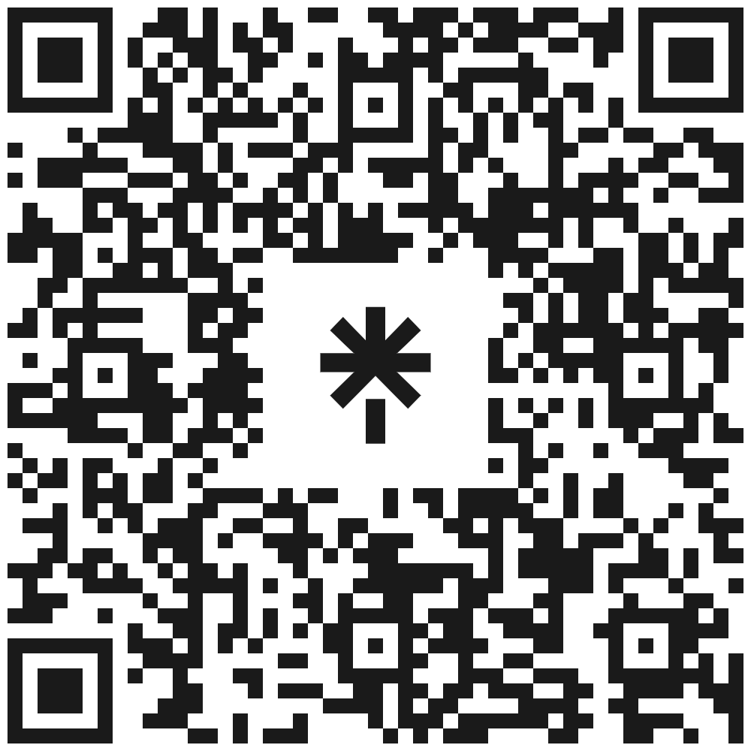
Mohamed Elbaiomy
Flutter Team Lead
ITI Certification
Creativa Benha Ambassador
Head Flutter GDSC Benha
Flutter Instructor
two years at 3C coding school
Certified Flutter developer from ITI
Current Season 2023 - 2024
at Stemate Benha

Slide 4
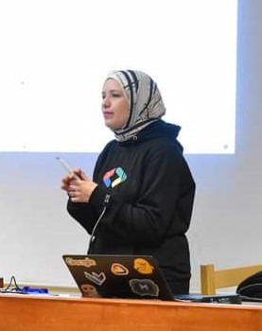



who influenced my life
Aya Sherif
Ammar Ageza
Salah Barakat
Reham Mostafa
Head of Flutter Season 2022
Co-Lead Technical Season 2023
Co-Lead Non-Technical Season 2023
Head of Flutter

Slide 5
Starting our First App
In Flutter, the main function is the entry point of your application. When you run a Flutter app, the main function is the first code that gets executed.
void main() {
runApp(const MyApp());
}
But before using runApp function you must write this line to import material package :
import 'package:flutter/material.dart';
class MyApp extends StatelessWidget {
const MyApp({super.key});
@override
Widget build(BuildContext context) {
return MaterialApp(
debugShowCheckedModeBanner: false,
home: Scaffold(
body: Text("GDSC Benha"),
),
);
}
}

Slide 6
MaterialApp vs Scaffold
Difference between MaterialApp and Scaffold:
MaterialApp is the top-level widget that represents the entire Flutter application and manages app-wide configurations, such as themes and routes.
Scaffold is a widget that represents the structure and layout of an individual screen or page within the app. It provides a basic framework for organizing and displaying different visual elements.
MaterialApp sets up the app-wide configurations and manages navigation, while Scaffold defines the structure and layout of a specific screen.
Typically, you have one MaterialApp instance at the root of the app, but you can have multiple Scaffold instances for different screens within the app.
MaterialApp represents the whole Flutter application and provides app-wide configurations, while Scaffold represents the structure and layout of an individual screen or page within the app.

Slide 7
Stateless vs Stateful
Stateless Widgets are those in which you want to make a UI that does not need to be dynamically changed whenever you update any value bound to it. For example, if you want to make a button whose title doesn’t need to change dynamically, then you can create a separate widget for a button as a Stateless widget.
Stateful widgets are just the reverse of Stateless widgets. This means when you want to make something that you want to change dynamically according to how a user interacts with it, then you can use the Stateful widget. For example, if you want to change the background color of the app on click of a button, you can make use of Stateful widget in this case.

Slide 8
Keys in Flutter
The key parameter in a widget's constructor is used to uniquely identify that widget. It is an optional parameter, and its purpose is to help Flutter efficiently update the user interface when changes occur.
By providing a key to a widget, you are telling Flutter to track that specific instance of the widget separately from other instances of the same widget. This can be useful in various scenarios, such as:
Efficient widget updates: When a widget's key remains the same across different builds, Flutter knows that the widget has not changed, and it can avoid rebuilding the entire subtree rooted at that widget. This helps in improving performance by minimizing unnecessary widget reconstructions.
Widget identification: In some cases, you may need to refer to a specific widget instance programmatically. By assigning a unique key to a widget, you can use that key to find, access, or manipulate the widget later.
State preservation: When widgets are rebuilt, their state is often lost. However, by providing a key, you can help Flutter associate the old and new instances of a widget, allowing it to preserve the state across rebuilds.

Slide 9
Main Scaffold Attributes
AppBar
Drawer
Body
used to define the top app bar of the screen. It accepts an AppBar widget as its value.
used to define a side drawer or navigation drawer in the app.
used to define the main content of the screen.

Slide 10
Text Widgets
01
Text
02
SelectableText
03
RichText
most basic widget for displaying a single line of text.
similar to Text, but it allows the user to select and copy the text
display styled text with multiple inline text spans. Each TextSpan within a RichText can have its own style

Slide 11
TextStyle Attributes
let's dive into the TextStyle class and its attributes, which is used to define the style of the text within the Text widget:
color: Sets the color of the text.
fontSize: Specifies the size of the text.
fontWeight: Determines the weight (boldness) of the text. It can be set to FontWeight.normal, FontWeight.bold, or other predefined values.
fontStyle: Sets the style of the text. It can be FontStyle.normal or FontStyle.italic.
letterSpacing: Specifies the additional space between letters in the text.
wordSpacing: Sets the additional space between words in the text.
decoration: Sets the decoration (such as underline or strikethrough) for the text. It can be combined with TextDecorationStyle and TextDecorationColor to define the appearance of the decoration.

Slide 12
Text Attributes
Text widget provides several attributes that can be used to customize the appearance and behavior of the text. Here's an overview of the attributes available in the Text widget:
data (required): The actual text content to be displayed.
style: Defines the style of the text. It accepts a TextStyle object.
textAlign: Specifies the horizontal alignment of the text within its container. It can be set to TextAlign.left, TextAlign.right, TextAlign.center, or TextAlign.justify.
textDirection: Sets the direction of the text, which can be either TextDirection.ltr (left-to-right) or TextDirection.rtl (right-to-left).

Slide 13
Icon Widgets
01
Icon
02
ImageIcon
display icons from various icon sets
display icons or images loaded from image assets
Other Amazing Icon Packages. Take a look at them. Font Awesome Flutter
Fluentui System Icons

Slide 14
Icon Attributes
Icon widget provides several attributes that can be used to customize the appearance and behavior of the icon. Here's a list of attributes available in the Icon widget::
IconData icon (required): Specifies the icon to be displayed. It accepts an IconData object, which can be chosen from various icon sets like Material Icons, Cupertino Icons, and FontAwesome Icons.
double size: Sets the size of the icon. The default value is 24.0. You can adjust the size based on your UI requirements.
Color? color: Defines the color of the icon. The icon will be displayed with the specified color. If no color is provided, the icon will use the current default color.

Slide 15
Activity

Slide 16
Layout widgets

Slide 17
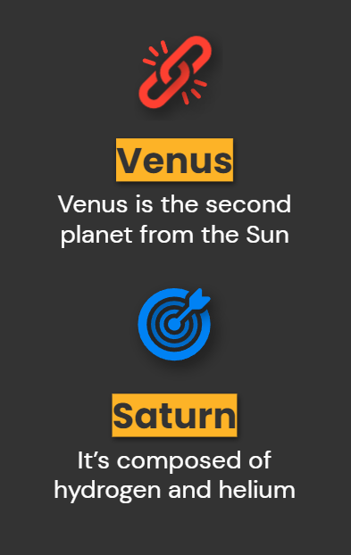
Center Widget
used to horizontally and vertically center its child widget within the available space.
takes a single child widget and centers it both horizontally and vertically within itself.
When it is used, it expands to fill the available space in its parent widget, and then positions its child widget at the center.

Slide 18
Vertical & Horizontal layout
Column
Row
arranges its child widgets vertically from top to bottom. It takes multiple children and stacks them on top of each other in the order they are specified. Each child can have its own alignment within the column.
arranges its child widgets horizontally from left to right. It also takes multiple children and arranges them side by side in the order they are specified. Each child can have its own alignment within the row.

Slide 19
Both Column and Row can contain any valid Flutter widget as their children, allowing for complex UI layouts. These layout widgets also provide properties such as mainAxisAlignment and crossAxisAlignment to control the alignment and distribution of children along the main and cross axes.
For example, you can use mainAxisAlignment to align children vertically in the Column or horizontally in the Row. Similarly, crossAxisAlignment can be used to control the alignment of children perpendicular to the main axis.

Slide 20
More Layout Widgets
Stack
Align
Padding
Positioned
Expanded
Flexible
stack multiple child widgets on top of each other
positions its child within itself based on predefined alignments
creating empty space between the child and its parent
used within a Stack to precisely position its child widgets. It allows you to specify the exact coordinates
used within a Column or Row to allocate any remaining space along the main axis to its child.
similar to Expanded but provides finer control

Slide 21
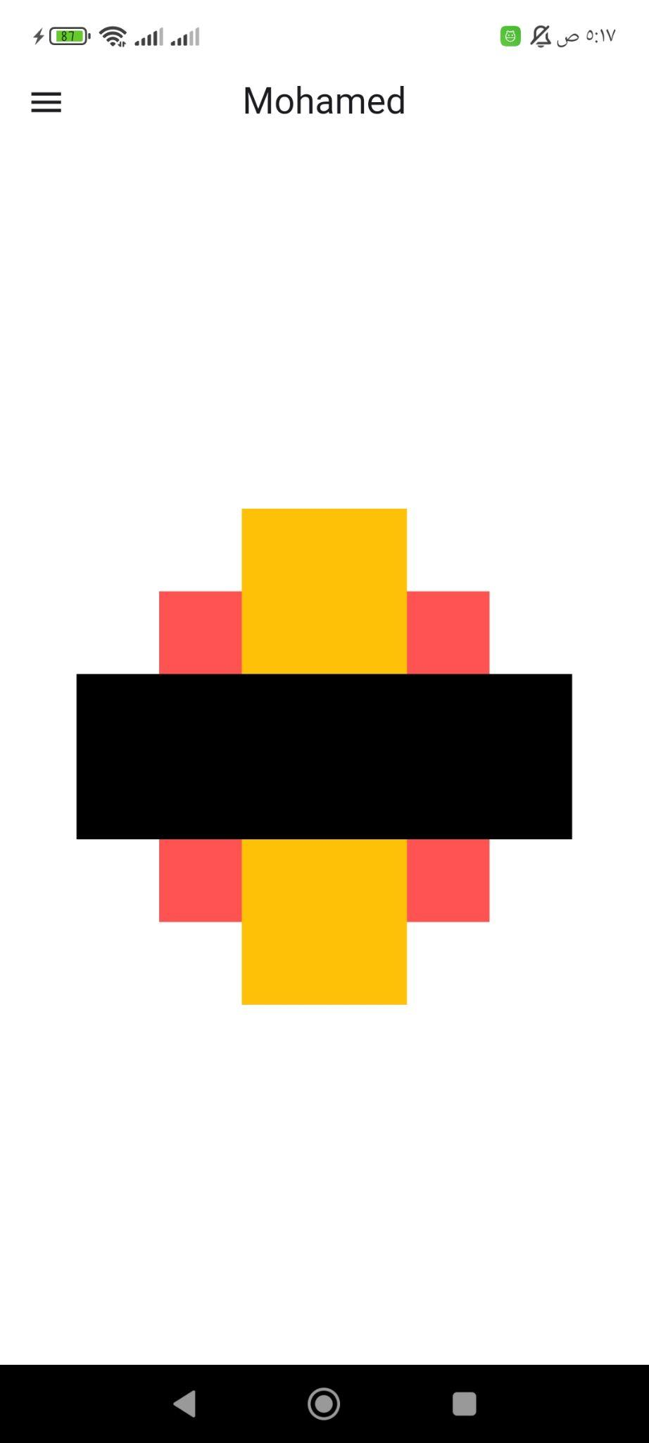
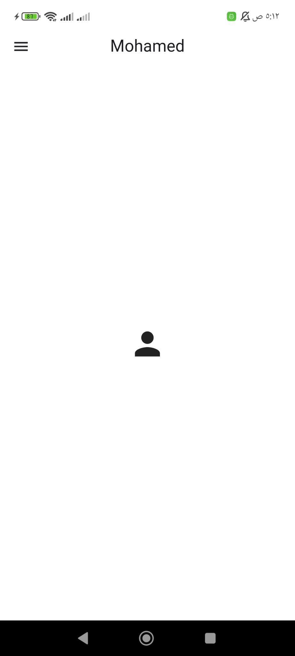
Our First App

Slide 22
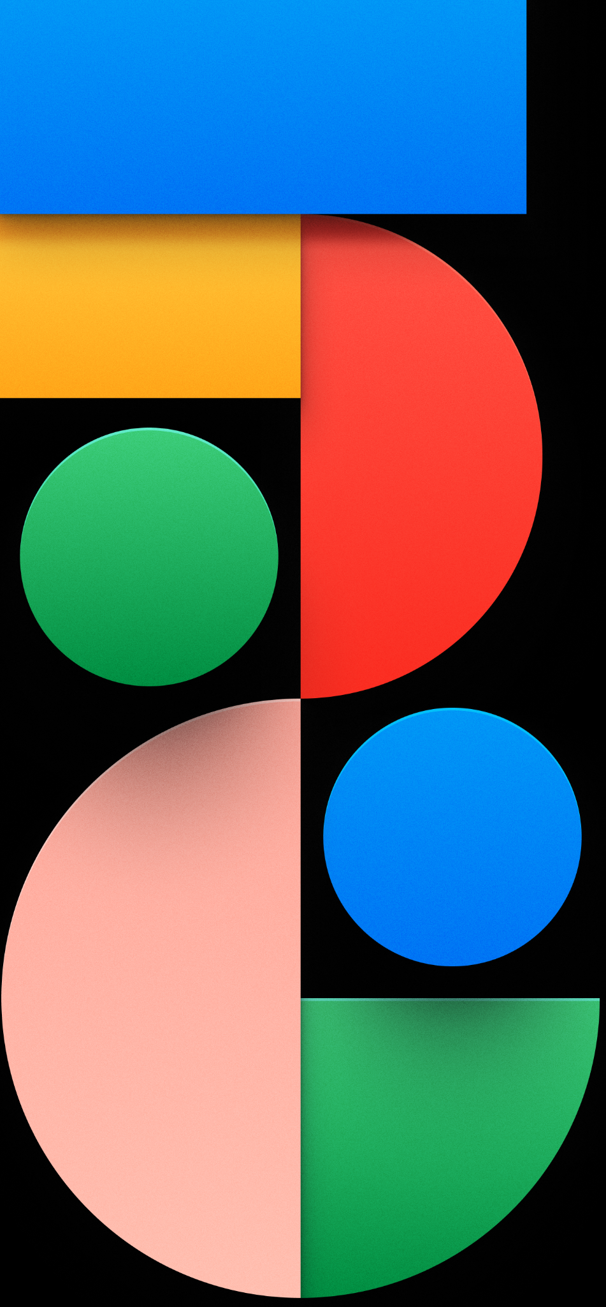
Images
Mohamed Elbaiomy

Slide 23
Dealing with Images
01
Image
02
Container
03
CircleAvatar
04
FadeInImage

Slide 24
Image
The Image widget in Flutter is used to display images within your application. It supports several representations of images, including AssetImage, NetworkImage, and more. Let's explore the two primary ways to use the Image widget:
using namedConstructor of the Class Image :
Image.asset(
'assets/images/my_image.png',
width: 200,height: 200,
),
using normalConstructor of the Class Image :
Image(
image: AssetImage('assets/images/my_image.png'),
width: 200, height: 200,
),

Slide 25
Container
you can use the decoration property along with the BoxDecoration class. The BoxDecoration class provides various options for styling and decorating the container, including adding a background color, border, or shadow.
Container(
width: 200,height: 200,
decoration: BoxDecoration(
image: DecorationImage(
image: AssetImage('assets/images/my_image.png'),
),
),
),

Slide 26
CircleAvatar
used to display circular images, such as user profile pictures or icons. It simplifies the process of creating circular image representations and provides additional customization options.
CircleAvatar(
radius: 50.0,
backgroundImage: AssetImage('assets/images/profile_picture.png'),
),
you can easily create circular representations of images with various sources, customize the appearance with background colors, overlays, or child widgets, and achieve visually appealing circular avatars in your Flutter app.

Slide 27
FadeInImage
used to display images with a fade-in animation as they load. It is particularly useful when displaying images that may take some time to load, such as images from network URLs or large assets.
FadeInImage.assetNetwork(
placeholder: 'assets/images/placeholder.png',
image: 'https://example.com/images/my_image.png',
),
The FadeInImage widget requires two images: a placeholder image and the target image. While the target image is being loaded, the placeholder image is displayed. Once the target image is fully loaded, it smoothly transitions from the placeholder image to the target image with a fade-in animation.

Slide 28
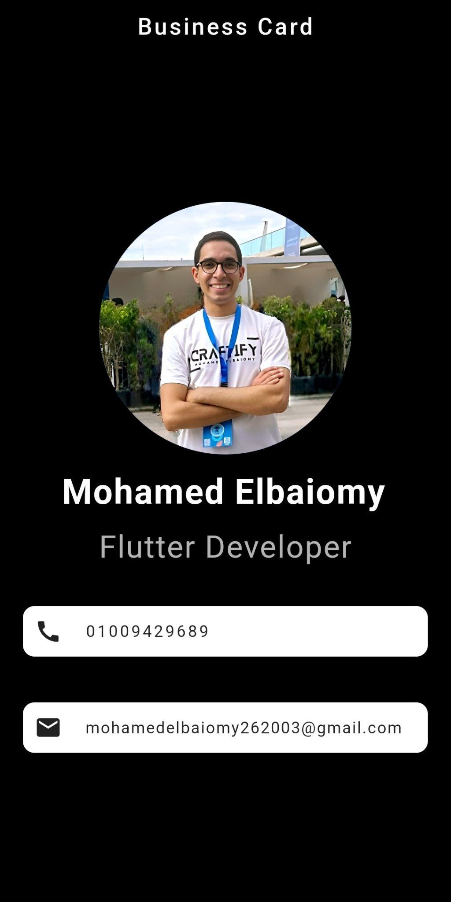
Our Goal Today

Slide 29
